Slide 1
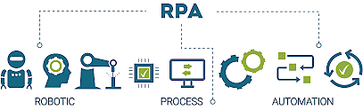
RPA Demo Session

Slide 2
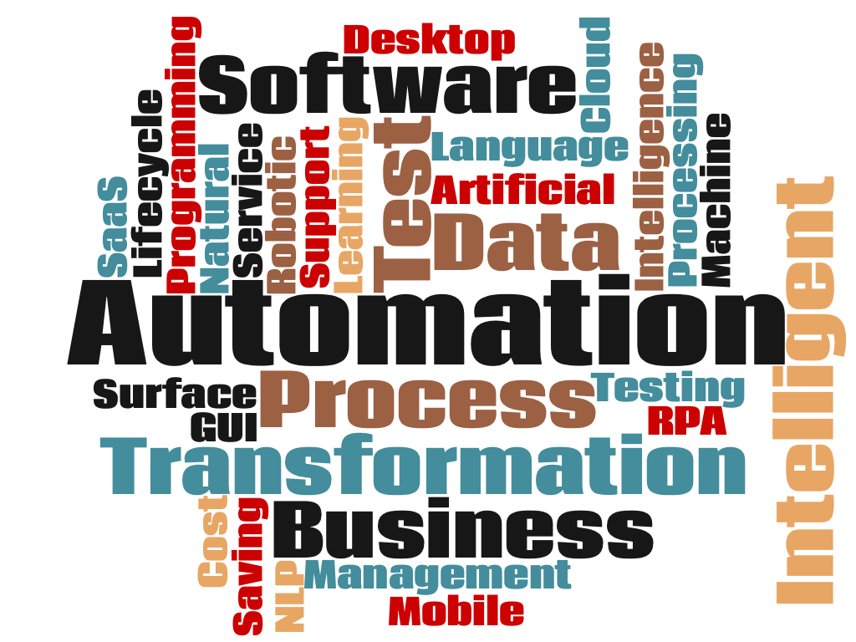
Introduction
RPA History
What is UiPath
Future Potential
Salary & Company, Job prospects
Programming required?
Example Automation
Question and Answers

Slide 3
RPA – Robotic Process Automation
The process of automating business operations with the help of robots to reduce human intervention is said to be Robotic Process Automation(RPA)
Robotic are entities which mimic human actions are called Robots.
A process is a sequence of steps which lead to meaningful activity. For example, the process of making tea or your favorite dish etc.
Automation is any process which is done by a robot without human intervention.
When we summarize all these terms together, then mimicking human actions to perform a sequence of steps, leading to a meaningful activity, without any human intervention is also known as Robotic Process Automation

Slide 4
RPA History
RPA is made up of a number of technologies, brought together under one toolkit to be deployed as and when needed for different automation purposes.
First steps towards the innovation which would eventually lead to the creation of RPA was Machine Learning (ML).
Credited that the name was first coined in 1959 by Arthur Samuel working for IBM.
Later in 1960, NLP(Natural Language Processing) developed to enhance the capabilities to conduct complex and language based tasks.
Since, NLP and Machine Learning where not much efficient to learn or understand humans do – for instance they can’t read between the lines.
So hence, RPA can be seen of implementing beyond NLP and Machine Learning or you can say combination of both and some add-on features.
Later in 1990’s RPA started with 3 key predecessors like Screen Scrapping, WorkFlow Automation(Back there in 1920, but later widely used after 1990), Artificial Intelligence(there in 1959 but enhanced or widely used after 1990)

Slide 5
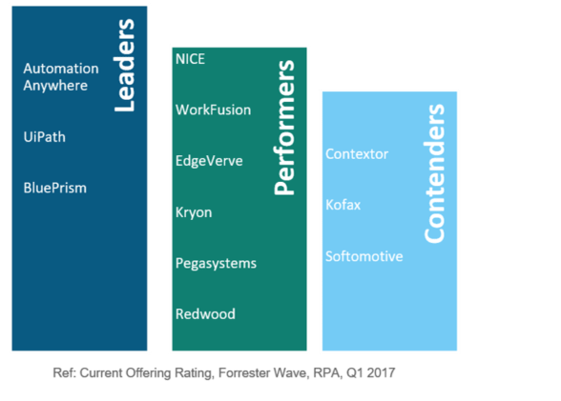
How To Get Started With RPA?
You need to follow the below steps, to get started with RPA:
Step 1: Gain extensive knowledge about the history behind RPA. That is, learn all about Traditional Automation.
Step 2: Learn about RPA and the various Applications of RPA.
Step 3: Choose the process that you wish to automate, and retrospect about the process dependencies. This is a way to make sure that your business doesn’t suffer loss while you are busy automating the task.
Step 4: Gain extensive hands-on experience in RPA Tools, such as UiPath, Blue Prism, and Automation Anywhere.

Slide 6
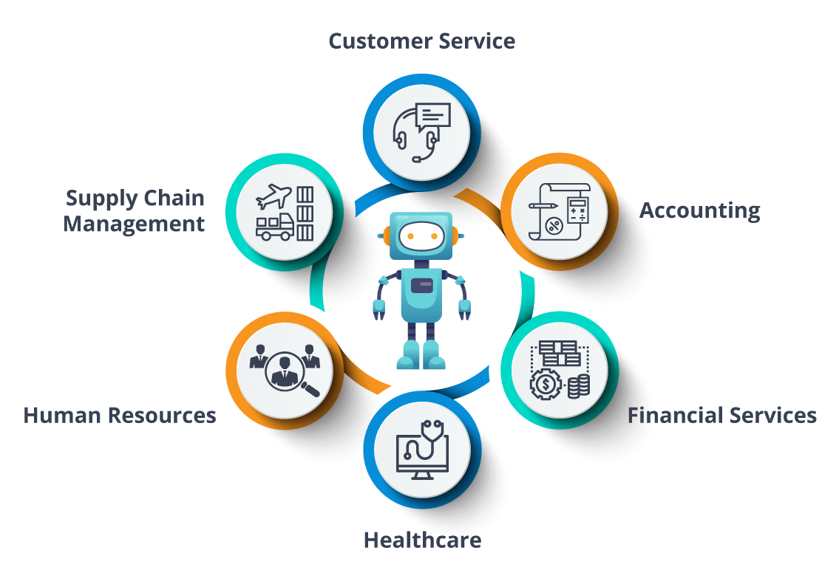
Domain where RPA can be used -

Slide 7
UiPath
UIpath is an advanced tool that enables you to design automation processes visually, through diagrams. UIpath executes the processes built in Studio, as a human would. Robots can work unattended (run without human supervision in any environment, be it virtual or not) or as assistants (a human triggers the process).
https://www.uipath.com/developers/video-tutorials/introduction-to-uipath
UiPath Studio - an advanced tool that enables you to design automation processes in a visual manner, through diagrams.
UiPath Robot - executes the processes built in Studio, as a human would. Robots can work unattended (run without human supervision in any environment, be it virtual or not) or as assistants (a human triggers the process).
UiPath Orchestrator - a web application that enables you to deploy, schedule, monitor and manage Robots and processes, while business exception handling is available through centralized work queues.

Slide 8
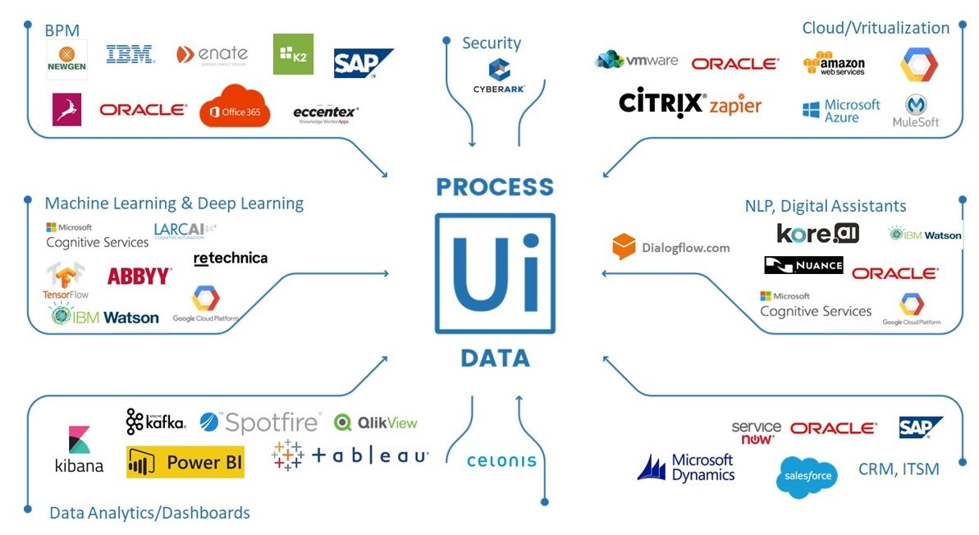
UiPath Emerging

Slide 9
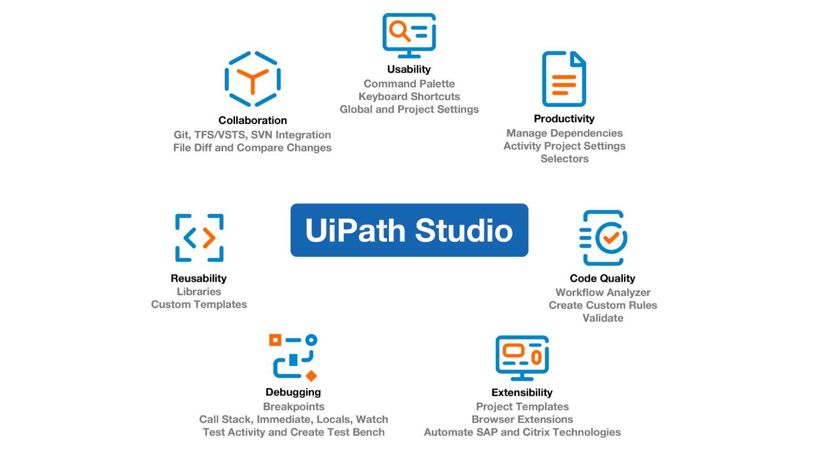
UiPath Features

Slide 10
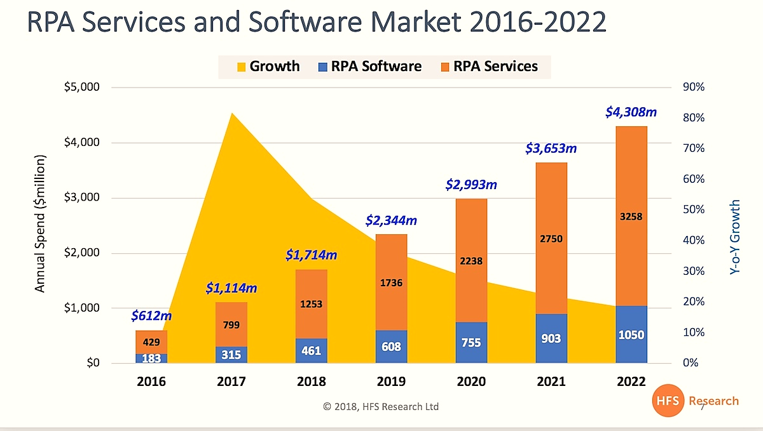
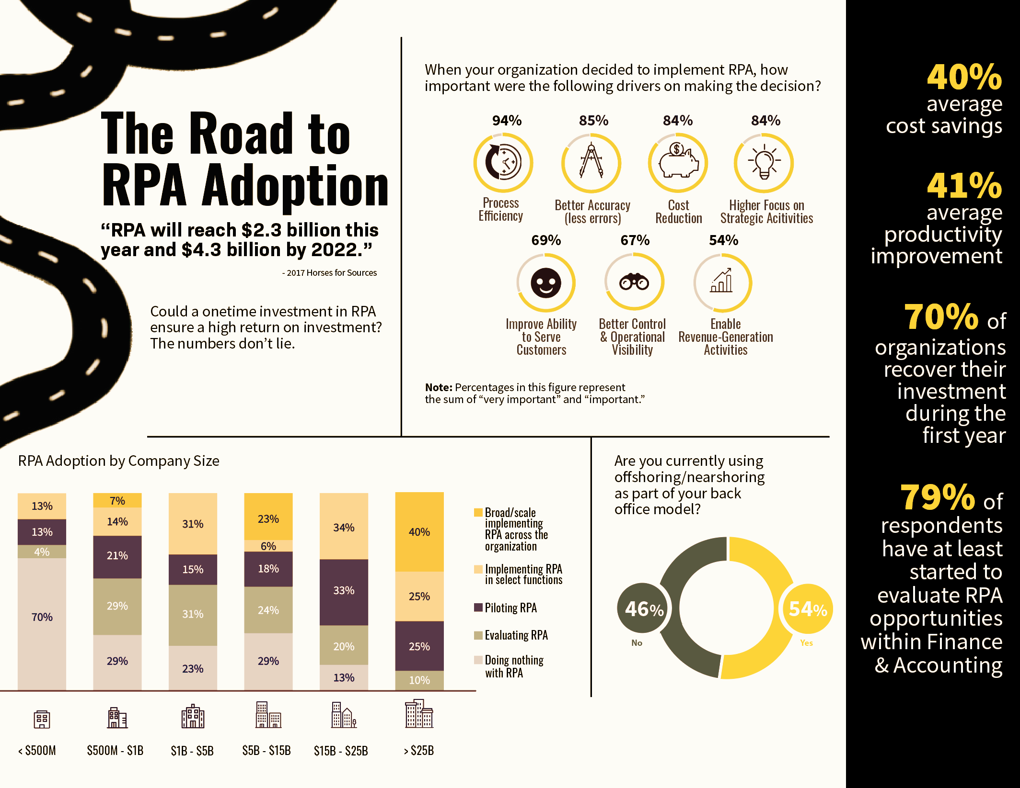
Future of RPA

Slide 11
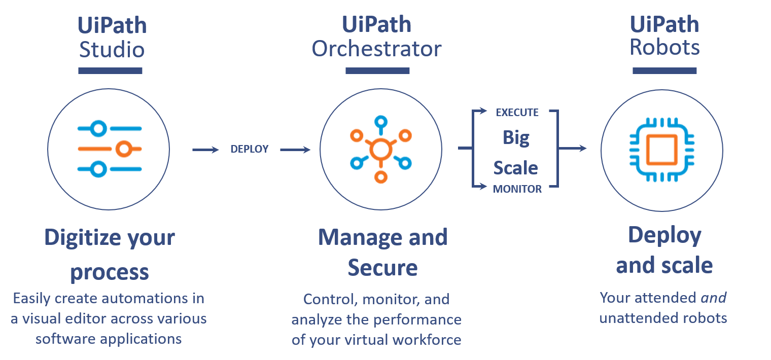
UiPath Flow

Slide 12
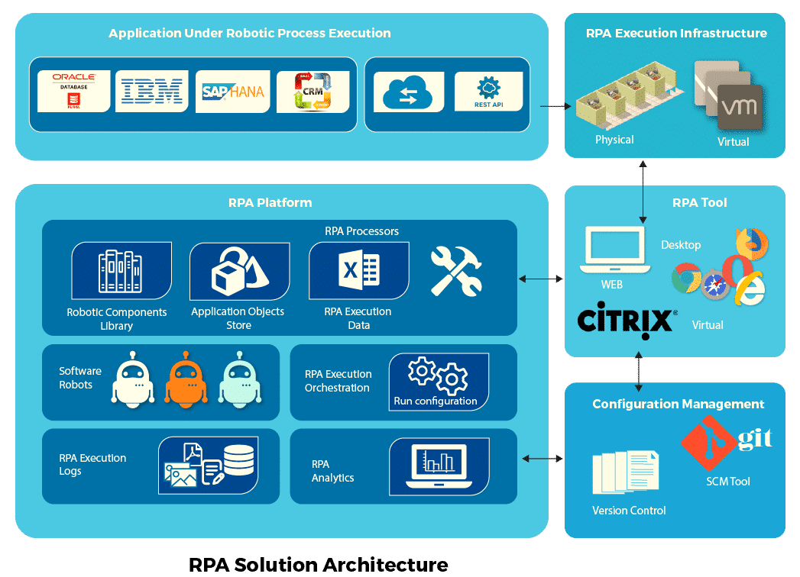

Slide 13
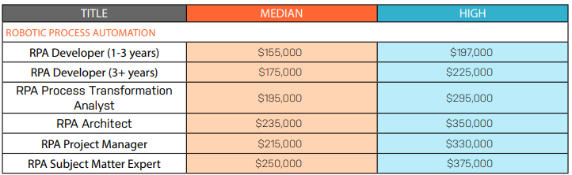
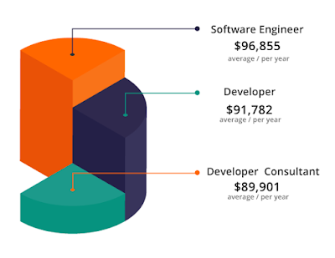
Salary for RPA Developer
RPA Developer: Process Designer Salary
INDIA
For Freshers or people with experience of 0-2 years – INR 6,00,000 to 8,00,000 per year
For Senior Role having experience of 2-6 years – INR 9,00,000 to 15,00,000 per year
USA
Average Salary Ranges from $ 84,000 to $ 132,000 per year
RPA Developer: Automation Architect Salary:
INDIA
For Freshers or people with experience of 0-3 years – INR 10,00,000 per year
For Senior Role having experience of 3-9 years – INR 19,55,000 per year
USA
Average Salary Ranges from – $128,000 – $170,000 per year
RPA Developer: Production Manager Salary:
INDIA
For Freshers or people with experience of 0-4 years – INR 7,01,000 per year
For Senior Role having experience of 4-10 years – INR 18,00,000 per year
USA
Average Salary ranges from – $68,000 to $125,000 per year

Slide 14
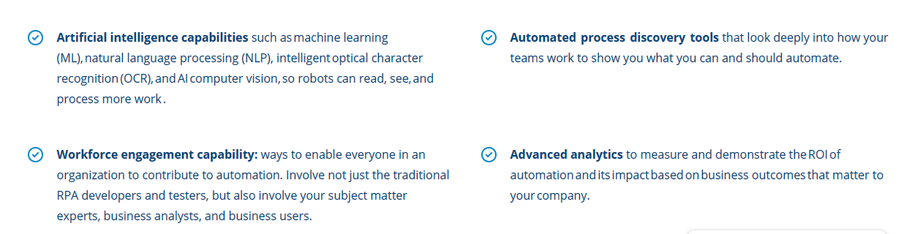
Beyond Automation - HyperAutomation
Now, we have question what is HyperAutomation?
Its nothing but bringing several components of process automation, integrating tools and technologies which will amplify the ability to automate.
It starts with robotic process automation (RPA) at its core, and expands automation capability with artificial intelligence (AI), process mining, analytics, and other advanced tools.
The idea is to automate more and more knowledge work, and engage everyone in an organization to be part of the transformation.

Slide 15
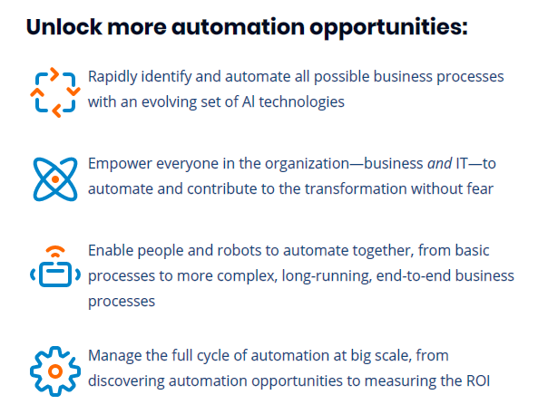
What are the benefits of hyperautomation?

Slide 16
What skill required to be a RPA Developer
Strong Problem-Solving and Analytical Skills
Experience with one or more RPA technologies (e.g. UiPath, Automation Anywhere, Blue Prism)
Programming (including scripting /coding), SQL and relational databases, and application development
Experience with Process Analysis, Design, and Implementation, Business and Technical requirements, Problem-Solving, and System(s) Testing, including UAT and Bug fixes
Should be able to Priorities and manage Multiple Portfolios
Basic understanding of Lean Six Sigma process methodologies
Programming languages like C/C++, Python, VB Script, Ruby, Java, JS, .Net
https://www.youtube.com/watch?v=ipJQm0pj5yg

